Slide 1

Study Buddy: Your Online Learning Companion
Presented by Team
AYESHA MASRATH
AMEENA TABASSUM
SADHWIKA

Slide 2
The Challenge: Isolation in Learning
In today's academic landscape, whether on sprawling campuses or in virtual classrooms, students frequently face a significant hurdle: isolation.
Struggling to Connect
Inefficient Methods
It's surprisingly difficult for students to find peers taking the same courses or sharing similar study schedules.
Reliance on word-of-mouth or chance classroom encounters proves inefficient for forming effective study groups.
This lack of connection can lead to decreased motivation and academic performance.

Slide 3



Our Solution: Study Buddy
Study Buddy bridges this gap, creating a vibrant ecosystem where students can easily connect, collaborate, and thrive.
Smart Matching
Interactive Features
Boosted Collaboration
Connects students with similar learning goals, courses, and schedules instantly.
Facilitates one-on-one chats, a query chatbot for instant help, and easy scheduling tools.
Encourages active collaboration, shared accountability, and a supportive learning environment.

Slide 4
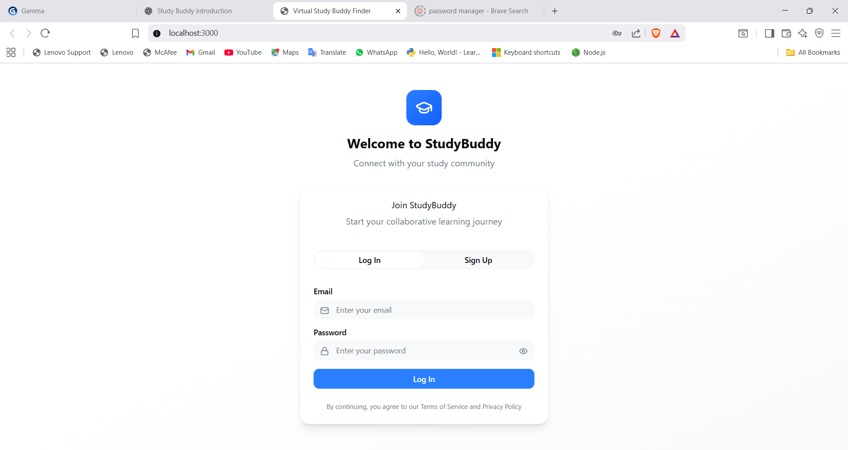
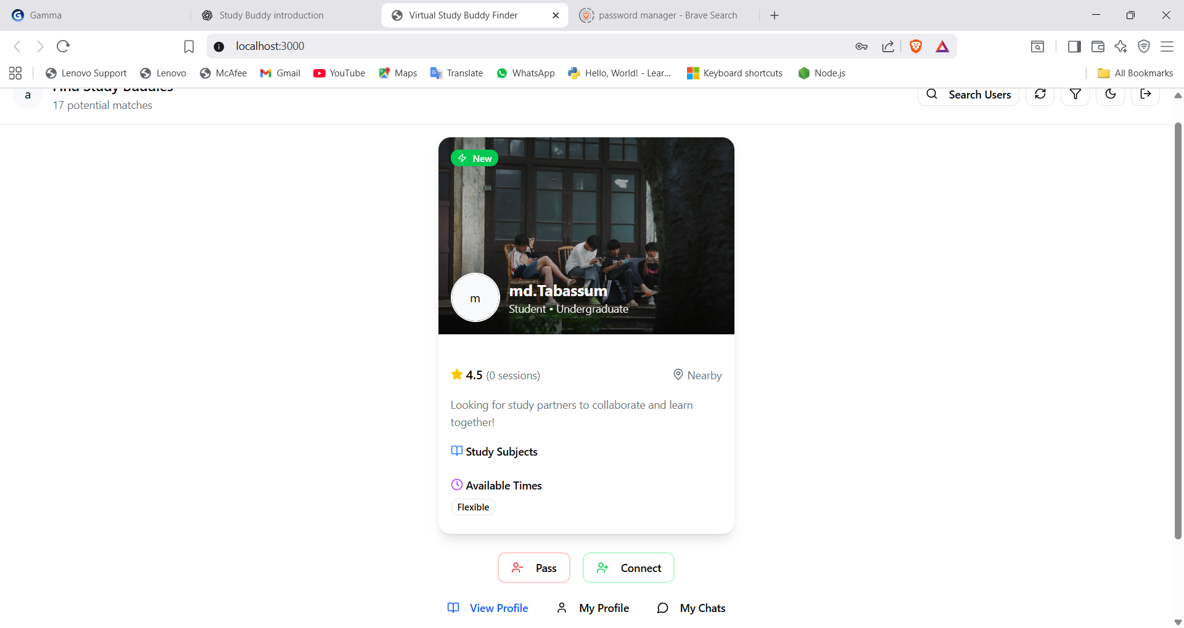
See Study Buddy in Action: The Demo
Our intuitive UI and seamless navigation make connecting and studying a breeze.

Slide 5
Under the Hood: Our Tech Stack
Frontend
Backend
React JS, HTML, CSS, and JavaScript
Node.js+Express
Database
Intelligence
SQLite
Integrated AI/ML

Slide 6






Impact & Benefits: Transforming the Learning Journey
Enhanced Motivation
Seamless Resource Sharing
Insightful Progress Tracking
Students stay more motivated and engaged through collaborative learning and peer support.
Effortlessly share study materials, notes, and engage in productive group discussions.
Monitor individual and group progress, identify learning patterns, and improve academic performance.
Study Buddy is designed to make learning more effective, enjoyable, and connected.

Slide 7
Future Forward: What's Next for Study Buddy
Mobile Accessibility
Full-featured mobile app version for iOS and Android, enabling learning on the go.
Smarter Suggestions
AI-powered study partner and resource suggestions based on user performance and preferences.
Engaging Gamification
Introduce badges, points, and challenges to boost motivation and foster healthy competition.
We envision Study Buddy as a comprehensive learning ecosystem that grows with its users.

Slide 8

Thank You for Your Time!
Presented by Team:
AYESHA MASRATH
AMEENA TABASSUM
SADHWIKA

